Slide 1
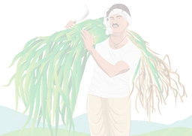
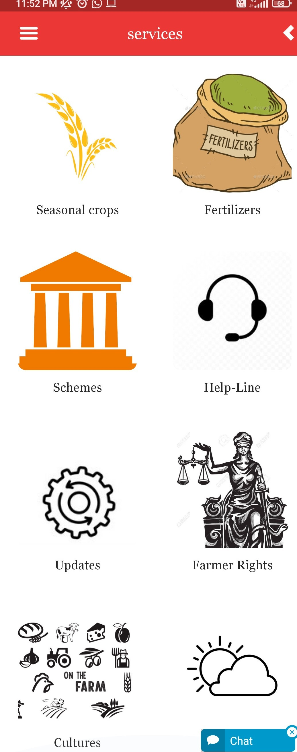




What inspired your team to choose this challenge?
India's More Than Half Of The Population (58%) Is Dependent On Agriculture For Primary Source Of Livelihood.
Still, they are facing many challenges due to unawareness of modern. technology and long past forgotten methods of farming.
No farmer-friendly interface apps Zero-knowledge about Right's of a Farmer.
Improper distribution of employment in a family.
skilled farmer
smart
≠ farmer
DOMAIN-AGRICULTURE
TEAM MEMBERS-
RUPA GUDUR
SARTHAK RANE VAISHNAVI HAMBIR
PRATHAM TEMKAR

Slide 2
What problem do they face?
Solutions provided by our app
H olistic information about crops.
The correct proportion of
What s easonal crops are to be grown?
Which and How many f ertilizers and pesticides to use?
What are new updates related to increasing productivity?
How and at What price to s ell?
Which s chemes are beneficial for that particular farmer?
L anguage barrier.
D epression/Stress/Help.
Unaware about c ultures of various farming methods.
Not understanding their R IGHTS and process of government.
fertilizers and pesticides.
U pdates regarding new techniques of farming.
M arketing strategies.
C entral and s tate schemes
D ifferent languages for different users.
E motional help-line for farmers.
D ifferent Sections for types of culture to be implemented according to your area.
A ll information regarding the
R IGHTS they have as a farmer.

Slide 3
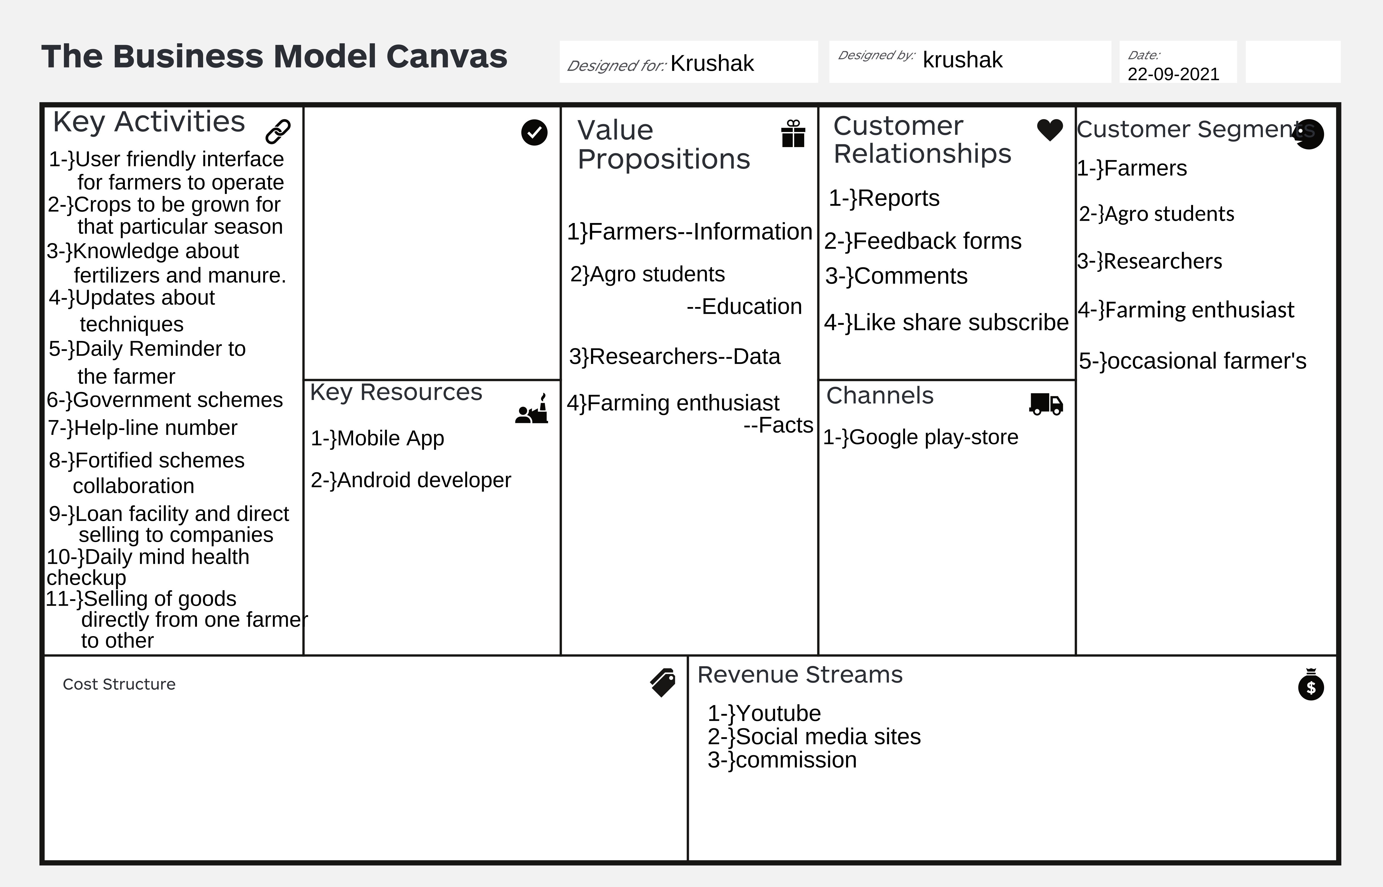


Slide 4
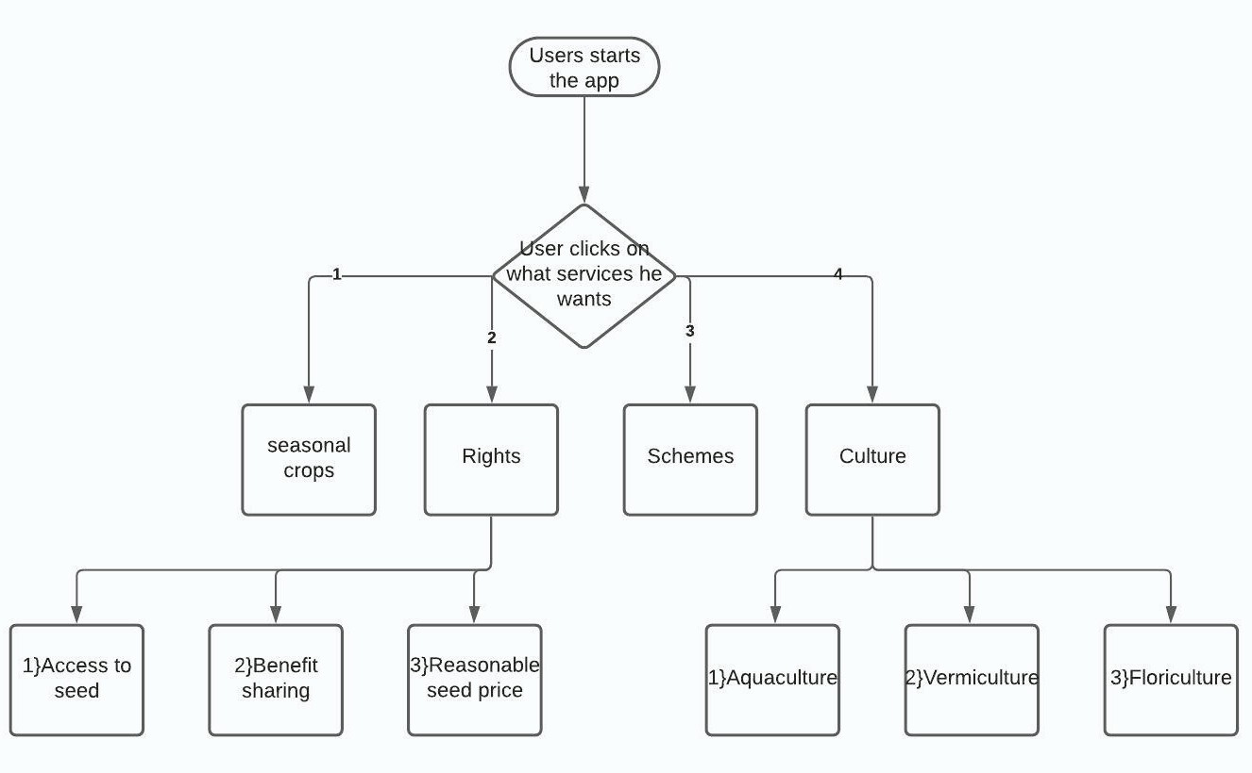
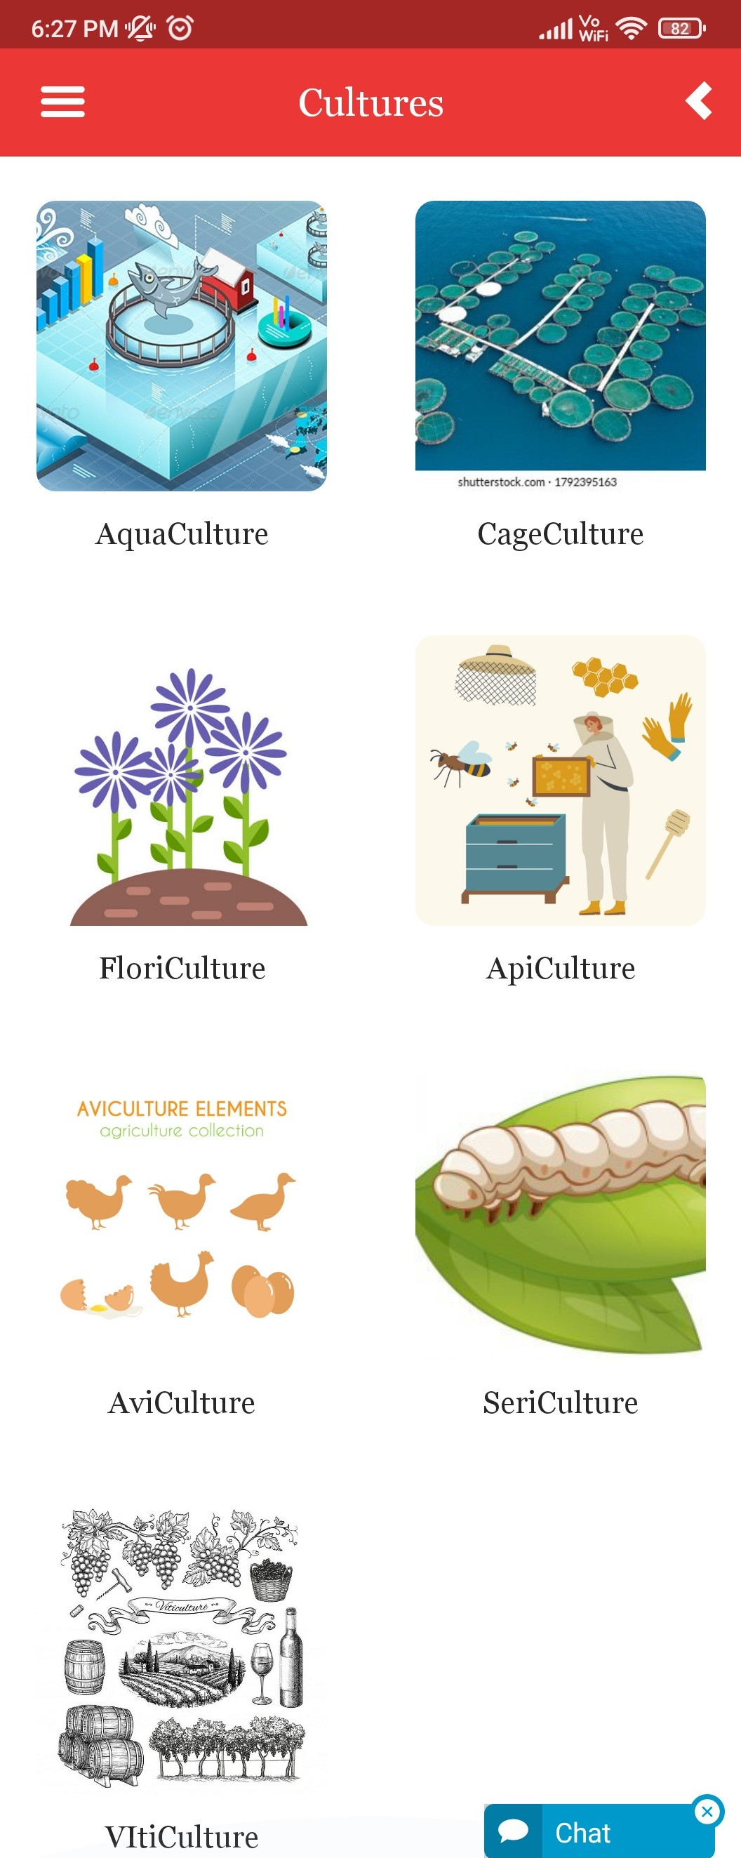


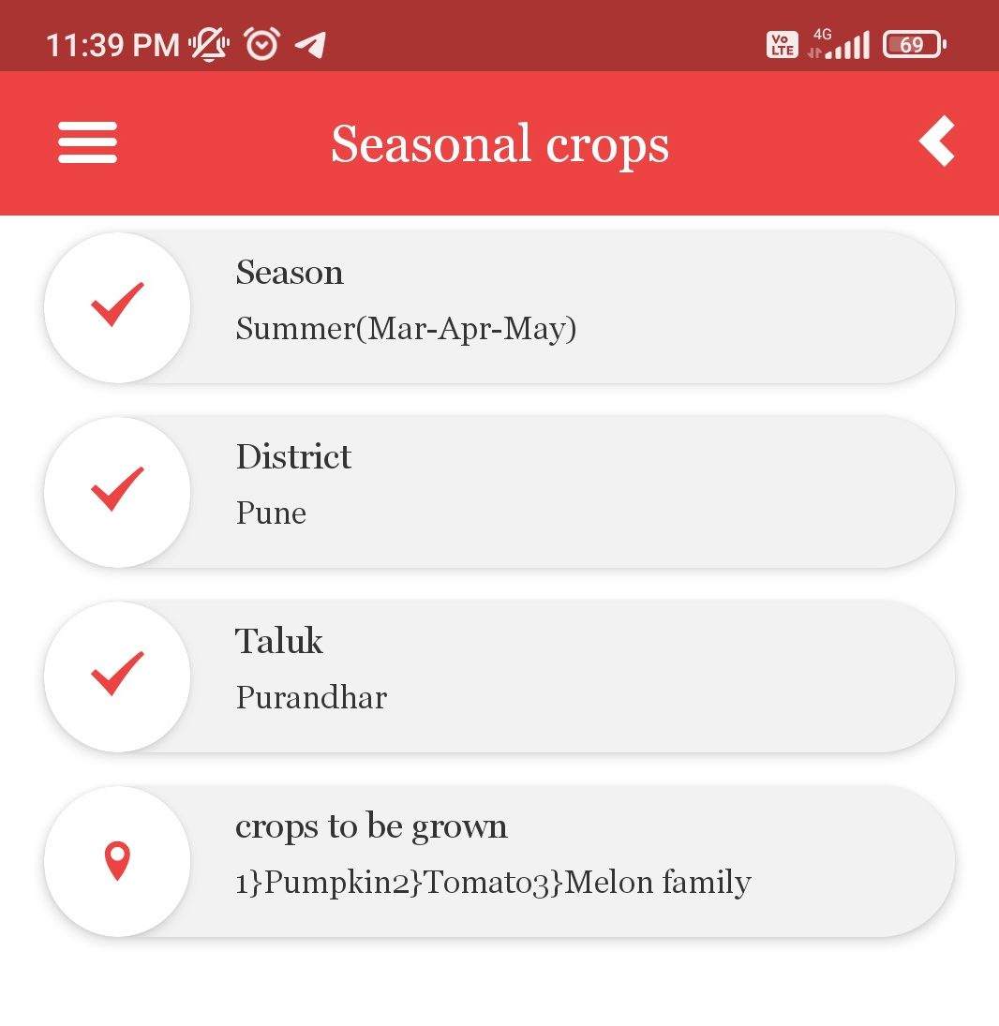

Slide 5
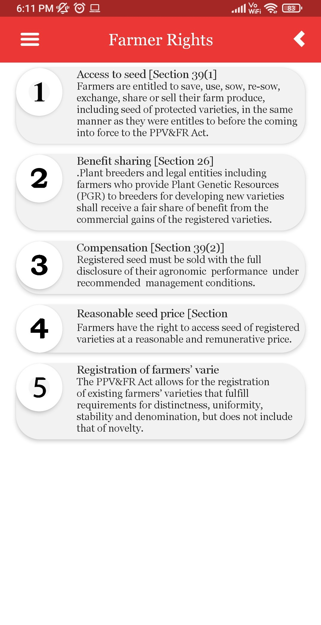
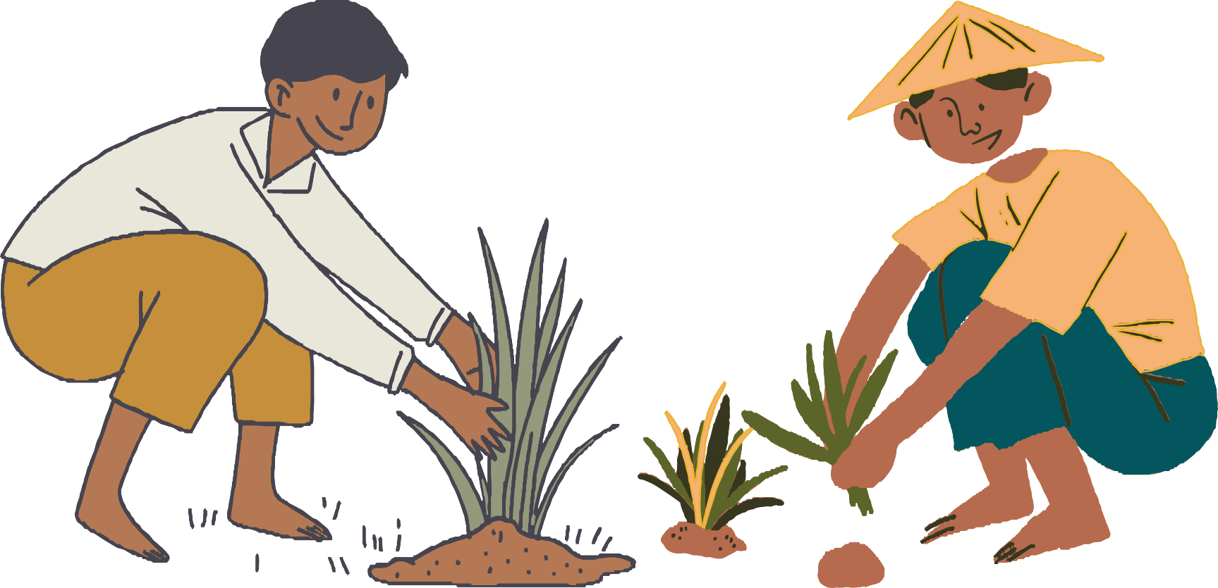
Features our app are providing which are not provided by other farming apps (why us?)
1}Productivity bar- Low-----------High. 2}Rights of a Farmer.
3}Cultures.
4}Detailed information about Seasonal Crops 5}Buy from and Sell to Farmers directly.
6}Help-Line for farmers where they can talk to loan advisors for loans, counselors, farming experts etc.
7}Daily reminder about their crops.
8}Soil testing methods , solar methods.
9}Insurance of crops.
10}Text-to-speech. 11}Booking of farming equipment's, bulls, peoples on rent.
HAPPY FARMER == HEALTHY FOOD
THANK-YOU

